Slide 2
3
Chapter
Preparing for a Career in Architecture

Slide 3
Objectives
Compare the duties and educational requirements of various career options in architecture.
Explain the advantages and disadvantages of entrepreneurship.
Describe the skills and traits employers look for when interviewing job applicants.
List workplace skills that have a positive effect on job performance.
Describe strategies for increasing your chance of promotion.
Explain the proper procedure for leaving a job.

Slide 4
Careers in Architecture
Many career and job opportunities in the architectural field
To find the right career, look at all alternatives
Review the career opportunities and skills needed that are explained in this chapter

Slide 5
Architect
An architect designs structures by working closely with a client
May also help client select a building contractor and represent the owner in dealing with contractor
Bachelor’s degree and license are required

Slide 6
Architectural Drafter
An architectural drafter draws details of working drawings and makes tracings from original drawings prepared by designer or architect
Educational requirements typically include:
high school diploma
some courses in architectural drawing
proficiency with CAD system and further technical study is desirable

Slide 7
Architectural Illustrator
An architectural illustrator prepares drawings, sketches, renderings, and other illustrations to present ideas to clients and to create advertising materials
Most work is done on computers
Educational requirements typically include:
high school diploma
some courses in architectural drawing
proficiency with CAD system and further technical study is desirable

Slide 8
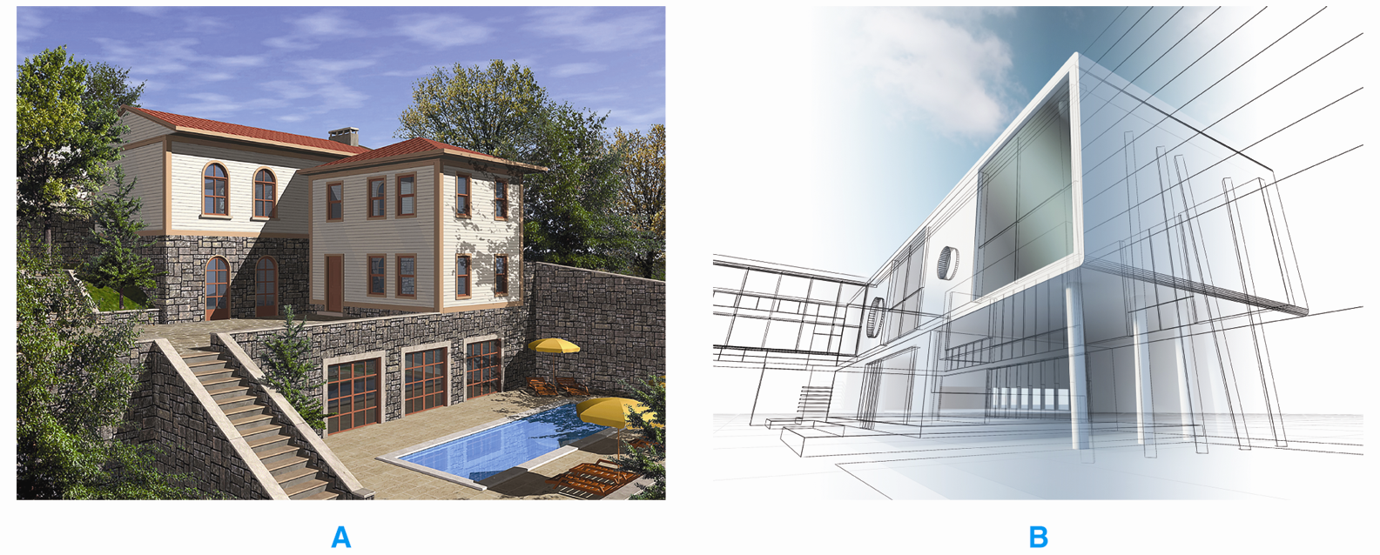
Architectural Illustrations
Two examples of drawings done by architectural illustrators.

Slide 9
Specifications Writer
A specifications writer prepares all written information needed to describe materials, methods, and fixtures in a structure
Must be knowledgeable in all phases of construction
Requires college degree with emphasis on technical drawing, industrial materials, and building construction

Slide 10
Estimator
An estimator calculates the costs of materials and labor for a building
Prepares all necessary paperwork related to the cost of the structure
Educational requirements include college degree with emphasis in math or economics
Computer experience necessary
Familiarity with computer-based estimating package advisable

Slide 11
Surveyor
A land surveyor establishes areas and boundaries of real estate property
Prepares property descriptions, maps, plats, and written specifications
Bachelor’s degree in surveying or civil engineering normally required
Surveying technicians complete two-year program and have practical experience

Slide 12
Teaching Architectural Drafting
Opportunities exist in high schools, trade or vocational schools, community colleges, and universities
Educational requirements include bachelor’s degree in architecture or industrial technology
Other requirements vary according to school and program
Advanced degree required to teach at college level

Slide 13
Architectural Engineer
An architectural engineer works with all systems within a building to integrate design, construction, and operation in the building
Requires bachelor’s degree in architectural or civil engineering

Slide 14
Construction Technologist
A construction technologist manages both supervisory and technical roles in construction industry
Specializations include managing construction, purchasing, and site supervision
Educational requirements include bachelor’s degree in construction technology
Experience in construction is helpful but not required

Slide 15
Residential Building Designer
A residential building designer plans and designs residential structures
Knowledgeable about codes, ordinances, design options, product choices
No specific educational requirements
Certified Professional Building Designer or National Council of Building Designer Certification indicates competency

Slide 16
Interior Designer
An interior designer designs interior space
Sometimes consulted in planning stages of new construction
Educational requirements include bachelor’s degree in interior design

Slide 17
Entrepreneurship
Person who starts, manages, and assumes the risks of a business is an entrepreneur
Failure caused by inadequate financing, poor management, or lack of knowledge
Has positive and negative aspects
Three ways to own a business:
Buy existing business
Buy a franchise
Start a new business

Slide 18
Entrepreneurs
Being an entrepreneur provides a great deal of freedom.

Slide 19
Employability Skills
Employability skills help you get and keep a job
Job skills are technical skills you need to perform a job correctly

Slide 20
Architecture
Green
Eco-entrepreneurship
Businesses that emphasize sustainable, environmentally friendly products and services
Green options available in all architectural areas
Careers that do not offer materials or process specifications, such as architectural drafting, can promote green processes in the office
Various websites offer information and tips on starting and promoting a green business

Slide 21
Job-Seeking Skills
First step is apply for job
Send résumé with job application
Prepare to make a good impression

Slide 22
Résumés
A good résumé provides information potential employers wants to know in a neat, concise format

Slide 23
Successful Interview Tips
Dress appropriately
Arrive promptly
Use good posture
Be prepared
Bring portfolio
Do not use slang
Demonstrate self-confidence
Thank the interviewer

Slide 24
Employability
Developing a résumé
Content varies based on type of job
Include contact information, present job position, work history, educational background, personal and professional accomplishments and recognitions
Common formats are reverse chronological and functional
Ask potential employers which file format to use when submitting a résumé

Slide 25
Workplace Skills
Workplace skills include:
Communication skills
Personal management skills
Teamwork skills

Slide 26
Communication Skills
The ability to explain new ideas and concepts clearly and to translate those ideas into plans
Includes speaking, writing, and listening
Active listening

Slide 27
Personal Management Skills
Personal management skills include:
Social skills
Avoiding discrimination and harassment
Productivity
Lifelong learning
Ability to balance work and personal life
Goal setting
Responsibility
Willingness to accept constructive criticism

Slide 28
Teamwork Skills
Employers look for employees who have teamwork skills
Ability to cooperate with others
Flexibility
Willingness to try new ways to get things done
Honesty and openness
Willingness to accept ideas of others

Slide 29
Strategies for Promotion
Do your current job to the best of your ability
Keep a positive outlook
Show eagerness to learn and contribute to the success of the company
Try to gain new knowledge and skills
Think ahead
Demonstrate good business etiquette
Be patient

Slide 30
Leaving a Job
Be considerate of the employer
Submit a letter of resignation
Maintain your professional attitude and be courteous throughout the leaving process

