Slide 1
Objective: To review the basics of the periodic Table
Do Now: Tell me what you know about the Periodic Table.

Slide 2
How the Periodic Table was arranged?
J.W. Dobereiner arranged the elements in groups of three by their similar properties
Example Iodine, Chlorine and Bromine
Dmitri Mendeleev arranged the first Periodic Table of Elements by increasing atomic masses

Slide 3
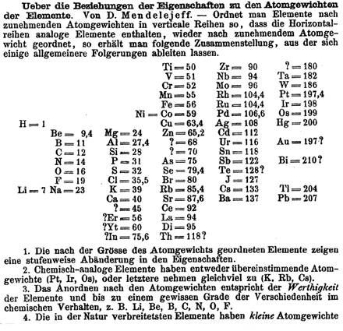

Slide 4
Periodic Table of Elements
Today’s Periodic Table of Elements is arranged by increasing atomic number
Elements in the same period (horizontal) have the same number of energy levels
Elements in the same group (vertical) have the same number of electrons in the outer shell, as well as similar chemical properties

Slide 5
Three broad classes of elements
Look at the periodic table, notice a thick “stair case”?
Elements touching the stair case are metalloids
Elements to the right of the stair case are nonmetals
Elements to the left of the stair case are metals

Slide 6
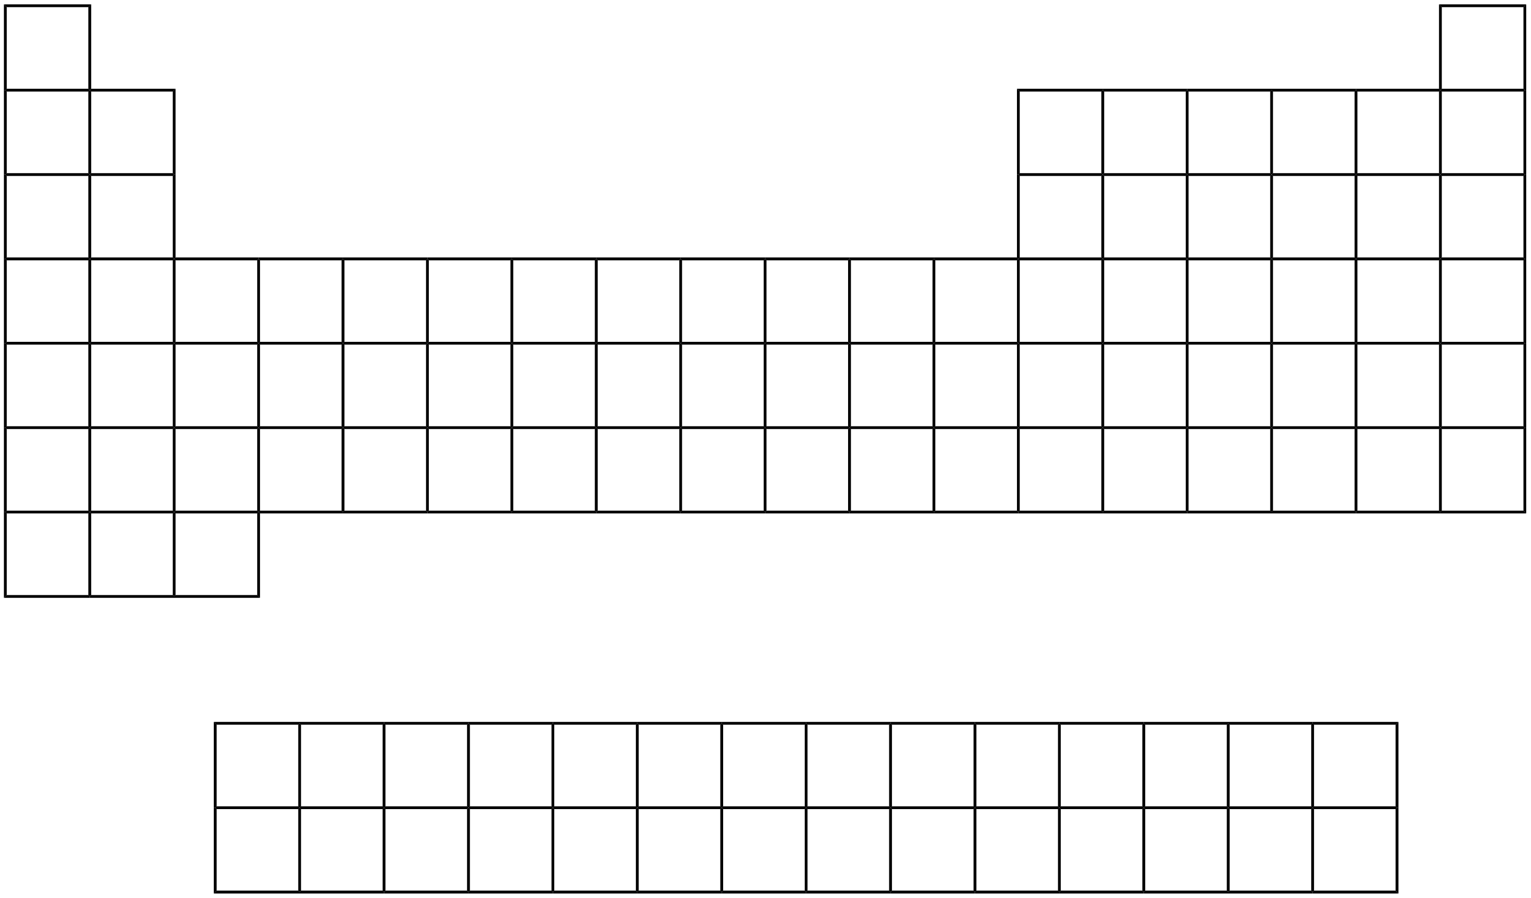
Red= metals
Green= metalloids
White = nonmetals

Slide 7
Metals are good conductors of heat and electric current, high luster, ductile, malleable
Nonmetals are poor conductors, (with the exception of carbon in the form of graphite) and brittle
Metalloids can take on characteristics of both depending on their conditions

Slide 8
Alkali Metals
http://www.bing.com/videos/search?q=reactivity+of+the+alkali+metals&view=detail&mid=0C59408C3A5D2F170AD80C59408C3A5D2F170AD8&first=0&qpvt=reactivity+of+the+alkali+metals
Located furthest group to the left (1A)

Slide 10
Other important groups in Periodic Table
Alkaline Earth Metals are in Period 2A, next to the alkali metals
Halogens, known as salt producers, are located in group 17 or 7A (next to the noble gases)
Noble Gases, also known as inert gases, are located the furthest in the right in group 18 or 8A

Slide 11
Red= alkaline earth
Purple= halogens
Green= noble gases

Slide 12
Other key groups
Representative Elements are the elements located in 1-7A, or the elements that stick out on the Periodic Table
Transition metals are the Group B elements located starting the fourth period, and occupy the d orbital in their outer shell
Inner transition metals (Lanthanide and Actinide Series/rare earth metals) are the two rows underneath the Periodic Table that occupy the f orbitals in the outer shell

Slide 13
Orange= transition metals
Blue= inner transition
Purple= representative elements

