Slide 1
5.1 Review Quiz game
We are not playing for extra credit, but to get a nice review

Slide 2
Quick Review before the review quiz game
1. 3 scientists you need to know are Rutherford, Bohr and Schrodinger
2. Each orbital you drew can hold 2 electrons (s=2, p=6, d=10)
3. You can have a fact index card for tomorrow’s quiz (so write down what you want on these cards for tomorrow)

Slide 3
Question 1: What was the limitation of Ernest Rutherford’s atomic model?
Answer: Failed to explain chemical behaviors

Slide 4
Question 2: Who created the atomic model that resembles a solar system?
Answer: Niels Bohr.
Electrons orbits around the nucleus in specific paths and orbitals

Slide 5
Question 3: Amount of energy required for electrons to move up and down orbitals is ___________________________.
Answer: Quantum

Slide 6
Question 4: What is the maximum electrons that can be in the 2nd energy level?
Answer: 8 electrons

Slide 7
Question 5: What was Niels Bohr’s limitation to his atomic model
Answer: He didn’t explain WHY electrons has limitations to its location and movement

Slide 8
Question 6: Who is Erwin Schrodinger? (be specific)
Answer: scientist who explained Niels Bohr’s model using mathematics

Slide 9
Question 7: name this orbital
Answer: p orbital

Slide 10
Question 8: What is the maximum amount of electrons an s orbital can hold?
Answer: 2 electrons.
There is only 1 s orbital per energy level and each orbital can hold 2 electrons max

Slide 11
Question 9: Which is the first energy level where you will see the d orbitals?
Answer: 3rd energy level.
Energy level 1- only has an s orbital
Energy Level 2- has s and p orbital only
Energy Level 3- has s, p and d orbital

Slide 12
Question 10: Draw what an s orbital looks like

Slide 13
Name this orbital (hint… look at the chart at the end of your notes and see which one I did not ask you to draw)

Slide 14
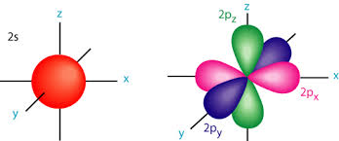
How many orbitals are present with the principle quantum number of 2?
2 ( s and p)
** if you said 4 because there are 3 p orbitals, you are not wrong, but look at the picture

Slide 15
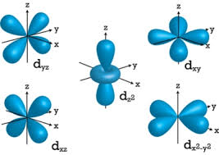
What a d orbital looks like when the 5 sub orbitals are together

Slide 16
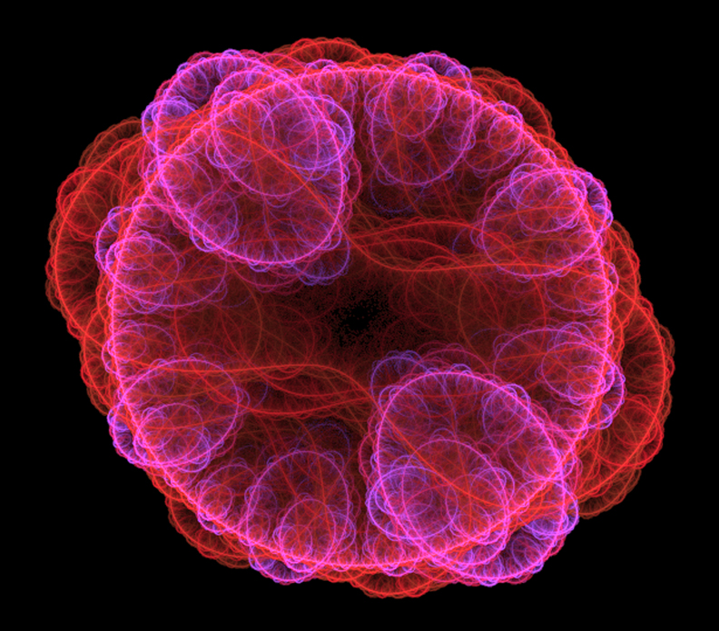
S and p orbitals

