Slide 1
Atomic Emission Spectra and Quantum mechanical Model

Slide 2
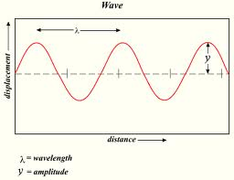
Waves

Slide 3
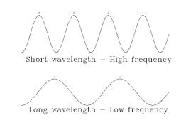
Low Frequency and High Frequency waves
Frequency is cycles per second

Slide 4
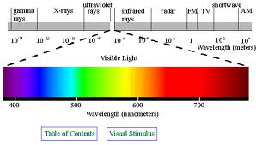
Electromagnetic Spectrum

Slide 5
Atomic Emission Spectra
Pattern formed when light passes through a prism or diffraction grating to separate it into different frequencies of light it contains
Atomic emission spectra is caused by atoms absorbing energy and the electrons move to the higher energy level.
When the energy goes back down to their lower energy level, it emits a light

Slide 6
Ground State/Excited State
Ground state: electrons at its lowest energy possible
Example: Sodium’s outer electron is in the s orbital
Excited state: electrons going to its higher energy
Example: Sodium outer electron going to the s orbital to p (p orbital is higher energy than s)

Slide 7
How are frequencies of light emitted by an atom in relation to changes of electron energy?
The electrons are moving from a higher energy to a lower (excited state to ground state)
http://www.youtube.com/watch?v=8M72pX5wlyE

Slide 8
Classical vs. Quantum Mechanics
Classical mechanics deals with larger objects (humans, cars, baseball, marbles
In quantum mechanics, matter moves like waves and it pertains to much smaller matter, such as light particles, atoms

Slide 9
Heisenberg Uncertainty Principle
It is impossible to know both the location and the speed of an electron at the same time

Slide 10
Famous scientist in quantum
Max Planck: energy changes in small units known as quanta (Energy= Planck’s constant x frequency) E=hv
Planck’s constant is 6.626 x 10⁻³⁴ Js
Albert Einstein: used Planck’s theory to explain the photoelectric effect
Photoelectric effect: light can be described as quanta and behaves like particles
Louis de Broglie: explains that all matter moves like waves

