Slide 1
Do Now: Describe the what the atom looked like according to Dalton, Thomson and Rutherford

Slide 2
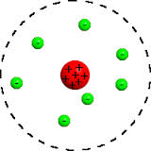
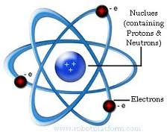
Rutherford’s Model and Its Limitations
You learned in chapter 4 that Rutherford concluded that the atom has a positively charged nucleus with electrons around it
His model failed to talk about chemical properties of the atom, like why metals changed colors when heated
His student, Niels Bohr, developed a new atomic model to explain these chemical properties

Slide 3
Niels Bohr
The electrons are found in specific circular paths, or orbitals around the nucleus, just like the solar system

Slide 4
Bohr’s Model
Each electron has a fixed energy, called energy levels.
Electrons can move up and down energy levels just like how we can move up and down a ladder
Quantum: the amount of energy required to move up or down an energy level

Slide 5
Limitations to Bohr’s Model
Although, Bohr’s model explains the path of the electrons around the nucleus, later calculations failed to consistently explain the electron’s motion
Erwin Schrodinger used mathematics to better explain Bohr’s atomic model (quantum mechanical model)
Determines allowed energies an electron can have and how likely it is to find an electron in various locations around the nucleus

Slide 6
Atomic Orbitals
Atomic Orbital: describes probability of finding an electron at various locations around the nucleus
Energy levels are labeled in principle quantum number (n) representing the energy levels
When n>1, there are more orbitals with different shapes that shows where the electrons can be found

Slide 7
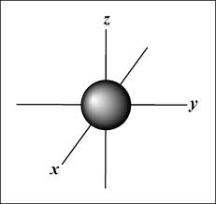
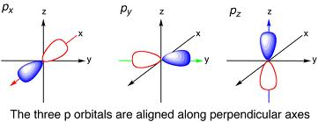
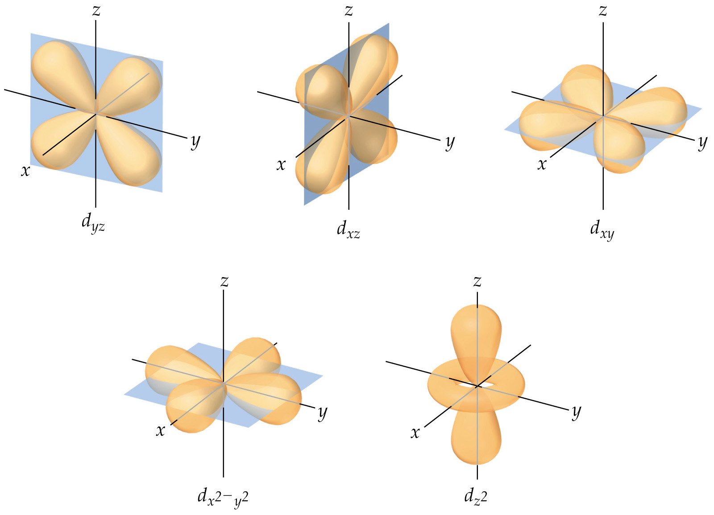

Slide 8
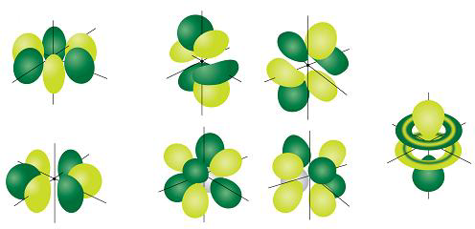

Slide 9
Summary of Principle Energy Levels and Sublevels
Principle Quantum Number (n) | Number of Sublevels | Types of Sublevels | Maximum number of electrons
1 | 1 | 1s | 2
2 | 2 | 2s, 2p | 8
3 | 3 | 3s, 3p,3d | 18
4 | 4 | 4s,4p,4d,4f | 32

