Slide 1
Objective: To introduce Periodic Trends
Do Now:
1. What do elements in the same Period (horizontal) have in common?
2. What do elements in the same group (vertical) have in common?

Slide 2
6.3 Periodic Trends

Slide 3
Atomic Size
As you go down the periodic table, the atomic size increases due to more energy levels
As you go across, the atomic size decrease because of the shielding effect and octet rule
Shielding effect: the nuclear charge pulls the outer electrons in closer the nucleus
Octet Rule: when the outer shell is filled with electrons, making the atom the most stable

Slide 4
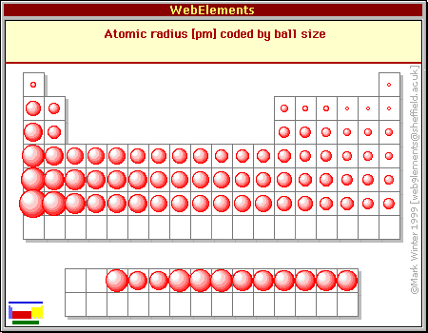
Atomic Size

Slide 5
Ions
Atoms that has a positive or negative charge
These form when electrons in the outer shell are transferred between atoms
Cation: positive ion/ loss electrons/ tends to be metals Example (Na⁺)
Anion: negative ion/ gained electrons /tends to be nonmetals Example (Cl⁻)

Slide 6
Ionic Size
Metals tend to be smaller when they become ions
Na is larger than Na⁺
Nonmetals tend to be larger when they become ions
Cl⁻ is larger than Cl

Slide 7
Electronegativity
The ability of an atom to attract electrons when atoms are in a compound
The most electronegative element is Fluorine
The least electronegative element is Francium
Easiest way to determine trend is how close/far apart are they from Fluorine and Francium

Slide 8
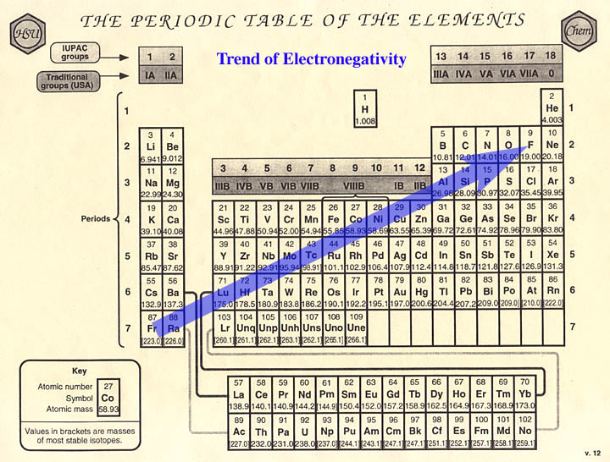
Electronegativity Trend

Slide 9
Try These Out
Put in order of increase atomic size
Nitrogen, Carbon, Boron, Oxygen
Put in order of higher electronegativity
Calcium, Cesium, Magnesium, Aluminum

