Slide 1
Do Now
Determine the stationary object in the middle of the box without peaking in the box

Slide 2
Atom
This chapter and the next will be about the atom and the theories of what something they cannot see looked like and how it works.
Atom- smallest particle of an element that retains its identity in a chemical reaction

Slide 3
Democritus’s Atomic Philosophy
He reasoned that atoms are indivisible and indestructible
Democritus did not have any scientific evidence to back his claim, as well as explain the chemical behaviors of an atom.

Slide 4
Dalton’s atomic theory
2000 years after Democritus’s philosophy, Dalton transformed his philosophy of an atom to a theory through experimental methods
Dalton’s formulated a hypothesis and theories to explain his observations known as Dalton’s Atomic Theory.

Slide 5
Dalton’s Atomic Theory
1. All elements are composed of tiny indivisible particles called atoms
2. Atoms of the same element are identical. Atoms of any one element will differ from those of any other element.
3. Atoms of different elements can physically mix together or can chemically combine in simple whole-number ratios to form compounds (2H to 1O make water)

Slide 6
Dalton’s Atomic Theory
4. Chemical reactions occur when atoms are separated from each other, joined, or rearranged in a different combination. Atoms of one element, however, are never changed into atoms of another element as a result of a chemical reaction

Slide 7
Subatomic particles
Much of Dalton’s atomic theory is accepted today. One major change to the theory is the fact that atoms are divisible and are broken down into three sub particles
Protons: positively charged particle (found in nucleus)
Neutrons: neutral charged particle (found in nucleus)
Electrons: negatively charged particle (found around the nucleus)

Slide 8
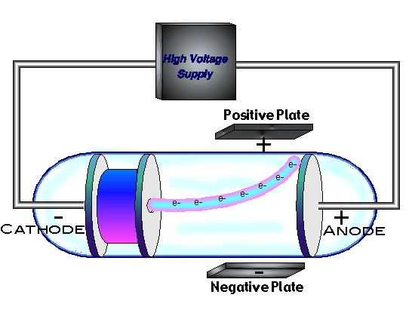
Electron
J.J. Thomson discovered the electron.
He used a cathode ray tube, where electrons travel from cathode to anode.

Slide 9
Mass of Electron
Robert A. Milikan performed the oil drop experiment to determine the mass of an electron

Slide 10
The electron wasn’t the ONLY sub particle discovered…
Eugen Goldstein discovered the proton using the SAME cathode ray tube experiment as JJ Thompson.
Each proton is 1840 times more massive than the electron
James Chadwick discovered the neutron 46 years later having the same mass of the proton.
It was Ernest Rutherford who concluded these sub particles were together in a nucleus of the atom using a gold foil experiment.

Slide 11
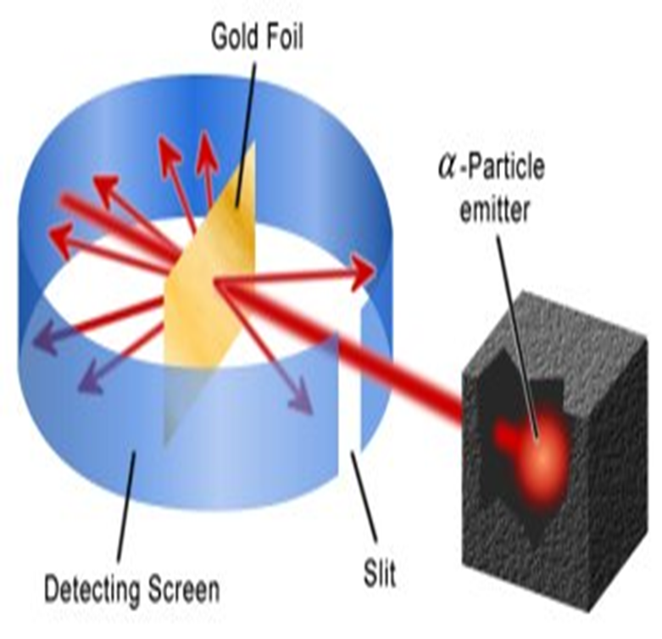
Gold Foil Experiment
Used alpha particles (which was helium that lost both of its electrons)
In theory, the alpha particles should have gone easily past a gold foil with a little deflection
Although most of the experiment is true, there was a small fraction that deflected in great angles

Slide 12
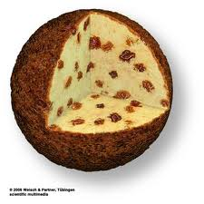
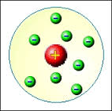
What does the atomic model look like, according to Dalton, Thomson and Rutherford?

